Slide 1
Al-Anon Outreach to Treatment Facilities Building relationships between professionals and family members
Module Three
Implementing the project
Al-Anon Family Group Headquarters, Inc.
Notes:
Note to Presenter: Read title/topic to audience.
(Click)

Slide 2
Module Three
Stage three, Implementation
Contacting and meeting with staff
Maintaining relationship with staff
Transitioning family members from the facility into Al-Anon.
Notes:
The subjects listed on the slide will be covered in this module.
(Click)

Slide 3
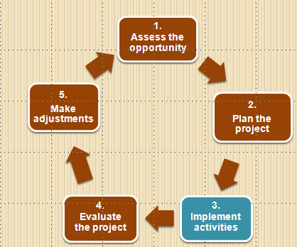
Stage three, Implementation
Notes:
Stage Three is the action portion of the planning process.
(Click)

Slide 4
Making contact
Personal contact is best
Describe the types of potential service projects
Offer to meet with the staff member
Exchange contact information
Al-Anon Family Group Headquarters, Inc.
Notes:
When contacting the facility for the first time to propose a service project, it may be necessary to explain the nature of our inquiry to the receptionist and ask for a referral to the correct staff person.
Once the correct person has been identified, in a preliminary telephone conversation the types of service projects we can provide can be briefly explained. Although a telephone call is more personal, it may be necessary to initiate contact via an e-mail message.
After initial contact has been made, face-to-face contact with a professional at the facility demonstrates our sincere interest and willingness to provide effective Al-Anon service projects to the families of alcoholic patients who are receiving services from the treatment center.
An appointment with the staff may not be possible, as it requires both volunteer and staff time. However, members are encouraged to offer to meet with staff to become personally acquainted with each other.
(Click)

Slide 5
Arrive and depart on time
Al-Anon Family Group Headquarters, Inc.
Notes:
When members meet with a professional, it is important to remember that the appointment is taking place in a business setting and that we are representing Al-Anon in our community as well as Al-Anon as a whole. It is okay for members to wear “business casual” attire. However, it is important for members to use common sense regarding the appropriateness of their choices of clothing in a business setting.
In all likelihood, the appointment will be set up on a day and time that is convenient for the staff member’s schedule. Our goal is to maximize the value of the allotted time.
Arriving late decreases the amount of time that the professional can meet with us and departing late will prevent the staff members from sticking to their plans and keeping to their schedules.
Arriving late also sends the message that we are not respectful of the professionals’ time, and are not reliable.
(Click)

Slide 6
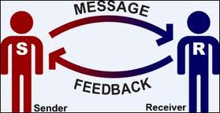
Let staff share about the facility’s activities and goals
Al-Anon Family Group Headquarters, Inc.
Notes:
Even though members have acquired background information about the treatment facility and its services prior to the appointment, it is a courtesy to let the staff member share about the programs offered by the facility and his staff assignment.
The professional may also want to give members a tour of the treatment center. A tour may give the Al-Anon contact ideas for future projects at the facility.
After gaining an understanding of the services provided at the facility, Al-Anon members can provide information about our program and local meetings.
(Click)

Slide 7
Offer a basic explanation about Al-Anon
Al-Anon Family Group Headquarters, Inc.
Notes:
Some professionals at treatment facilities are familiar with A.A. and Al-Anon and may even be members. Others, however, are unfamiliar with our purpose and our meetings.
You will want to get a sense of how familiar the professional staff is with Al-Anon and make adjustments according to their level of understanding.
(Click)

Slide 8
“Keep It Simple”
Al-Anon’s purpose
Who can attend
Al-Anon
Types of meetings
Our meeting format
Anonymity and
confidentiality
How to obtain local
information
NO
COMPLICATIONS
ALLOWED!
Al-Anon Family Group Headquarters, Inc.
Notes:
The objective of this meeting is to help staff become comfortable in making the Al-Anon program available to the family and friends of their clients.
In addition to basic information about Al-Anon and Alateen, we also need to help staff and family members understand that although we are different from groups facilitated by a professional, Al-Anon does not conflict with professional help, and that Al-Anon can be very helpful to people who are receiving help from a professional.
Always end by letting staff know that interested family members will receive more information about Al-Anon when they attend their first meeting.
(Click)

Slide 9
Al-Anon outreach literature
Al-Anon Faces Alcoholism magazine is strongly recommended
Local meeting schedules
Let staff assess the suitability of the items
Al-Anon Family Group Headquarters, Inc.
Notes:
We all have our favorite pamphlets, but it is important to “Keep It Simple” when showing our literature to staff. Much of our literature is open to potential newcomers from any type of background. But there are items that are targeted to a type of relationship, cultural community, mental health, or treatment settings.
It is important to give professionals the opportunity to review the materials that members want to distribute to the family members of their clients. They can tell us what would be most helpful.
Limiting our literature to a few introductory items also makes it easier for the Public Outreach Committee to fund the activity, e.g., Al-Anon Faces Alcoholism magazines or What Happens After Treatment (P-81 ES or P-81 EF).
(Click)

Slide 10
Provide local Al-Anon contact information
Current meeting
schedules
Al-Anon telephone
numbers
Web site and e-mail
addresses
Notes:
It is essential to give family members a meeting schedule. If giving schedules directly to families is not an option, an alternative could be to leave copies in a waiting room with permission from the staff.
It is the responsibility of the local Al-Anon Public Outreach Committee to make sure that the facilities have current local meeting and contact information. When the meeting schedules or contact information changes, the materials provided by local members need to be updated.
It’s also a good idea to include the WSO’s toll-free meeting information number and Web site address in addition to the local service arm contact information as some family members come in from out of town and this will afford them the opportunity to locate a meeting when they return home.
Some treatment facility staff may prefer to include Al-Anon contact information in a list of other types of Twelve Step and self-help support groups for family members. The professionals let their clients decide which support group they wish to attend.
(Click)

Slide 11
Maintaining a relationship with staff
Al-Anon Family Group Headquarters, Inc.
Notes:
Note to Presenter: Read title/topic to audience.
(Click)

Slide 12
touch
Stay
in
Take the initiative
Maintain contact at periodic intervals
Ask for feedback about current service projects
Al-Anon Family Group Headquarters, Inc.
Notes:
The Al-Anon contact(s) can call periodically or send an e-mail message to the facility staff member. This demonstrates to the professional that Al-Anon members want to be consistent and effective in their work at the .
Communicating with the staff member at regular intervals also gives members the opportunity to ask if there are any concerns. Inviting the staff contact to express concerns allows members to make changes before they become major problems. Staff also receive feedback from family members, colleagues, or alcoholics receiving treatment. This is invaluable to the Al-Anon volunteers, so that they know what is working well and what needs to be improved.
(Click)

Slide 13
A schedule for our activities is essential
Things to include:
Presentation dates and
times.
Members’ names and
contact information.
Dates to replenish literature
and meeting schedules.
Dates to communicate with
staff.
Al-Anon Family Group Headquarters, Inc.
Notes:
Some facility family programs, counseling or treatment sessions are so full that there isn’t time for us to give a presentation, workshop, or conduct a beginners’ meeting. It may be possible for staff to arrange or encourage the family to attend a local Al-Anon meeting. Some local Public Outreach Committee may only be providing literature and meeting schedules to the treatment facilities.
Adding a beginners’ meeting is an expansion of our outreach to the treatment facility, though in some cases, Al-Anon may start its outreach to the treatment center with an introductory meeting.
The Al-Anon member serving as the Project Coordinator should set up a schedule for various aspects of the project. If Al-Anon has committed to providing literature and meeting schedules to the treatment facility, the Project Coordinator should set up regular schedule to check back with the facility, and replenish the supply of printer materials—meeting schedules, copies of
Al-Anon Faces Alcoholism, or other literature.
If there are beginners’ meetings or workshops planned, those schedules need to include the days and times for these presentations, and the names and contact information for the members who have volunteered for this or other types of Al-Anon services at the facility.
This calendar will enable the Coordinator of the outreach service(s) and the members participating to know exactly what and when they are to provide the service. In addition, the schedule also includes contact information for other members when substitutes are needed.
By managing this aspect of the project effectively, Al-Anon’s relationship with the treatment f center will be solidified as the facility comes to see us as reliable and trustworthy, which gives them the confidence to send the families of their clients to Al-Anon.
(Click)

Slide 14
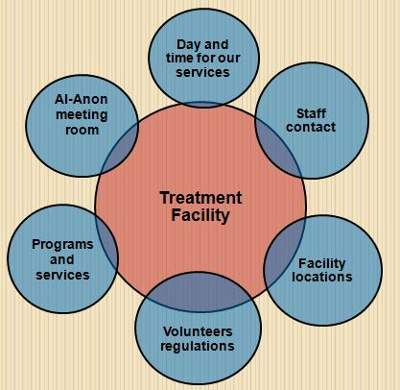
Adjust promptly to changes at the facility
Notes:
The facility, as a business entity, can make modifications at any time. We need to comply with the new procedures so that we maintain our cooperative relationship with the treatment center.
If Al-Anon has problems with the facility’s changes, our contact should ask for the assistance of the staff member who serves as our liaison at the center.
(Click)

Slide 15
Transitioning family members from the facility to Al-Anon
Notes:
Presenter: Read title/topic to the audience.
The shift from family services to our program during or after the alcoholic is or has received treatment is major.
(Click)

Slide 16
Remember how you felt at your first meeting?
Family members are often
Exhausted
Overwhelmed
Distrustful
Fearful of being judged
Notes:
If your resources permit, and the treatment facility is willing, schedule an Al-Anon introductory or “meeting on wheels,* on a regular basis. It can help family members become more comfortable with the idea of attending an Al-Anon meeting.
*See the “Meeting On Wheels” Guideline (G-22).
Another way to familiarize families with our program is for our members to sponsor a meeting at the facility or hotel where family members stay when attending a three to five day residential program specifically for the family members.
Not all family members have attended an Al-Anon meeting or a presentation while receiving services from the facility. So, they may be unfamiliar with our meeting format, the Traditions, and discussions chaired by members instead of a professional.
We need to remember to “meet them where they are” and to avoid overwhelming the family members with too much information.
(Click)

Slide 17
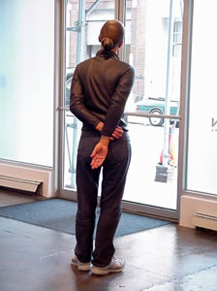
A “meeting before the meeting”
Ask an Al-Anon member to meet with a
family member before the Al-Anon meeting
Notes:
It is helpful to let the professionals at the treatment facility know that more experienced Al-Anon members will be available to introduce newcomers to
Al-Anon, and answer their questions before the meeting begins.
Newcomers feel more comfortable when they have background information and know what to expect. A more experienced member can explain our meeting format and the Tradition of anonymity. This is helpful as some newcomers need reassurance that it is okay if they do not wish to speak or identify themselves at the meeting.
Another benefit is that the newcomer can walk into the meeting room with a member instead of entering alone.
(Click)

Slide 18
Find the balance between “swarming around” and “giving space” to the newcomer
Notes:
Although our hearts are in the right place, members welcoming the family members need to be able to adjust how newcomers are welcomed. Each family member has individual preferences.
Some newcomers welcome our attentiveness, like a private meeting a few minutes before the meeting, while others prefer to be left alone.
The same is true with information, some people want a lot of information yet others are overwhelmed by it.
Many times providing a Newcomers Kit (K-10) and a meeting schedule is enough to get them started. Let them know they can pick up additional pamphlets and books at future meetings.
(Click)

Slide 19
Service projects are a commitment
Al-Anon Family Group Headquarters, Inc.
Notes:
Note to Presenter: Read title/topic to audience.
(Click)

Slide 20
Congratulations! Now it is time for Module Four
Al-Anon Family Group Headquarters, Inc.
Notes:
Note to Presenter: Read title/topic to audience.
(Click)

