Slide 1
Al-Anon Outreach to Treatment Facilities Building relationships between professionals and family members
Module Four
Evaluating results, making adjustments
and celebrating our successes
Notes:
Note to Presenter: Read title/topic to audience.
(Click)

Slide 2
Module Four
Stage four, Evaluation
Stage five, Making adjustments
Celebrating our successes
Notes:
The remaining stages of the five step planning process are “evaluation” and “making adjustments.”
(Click)

Slide 3
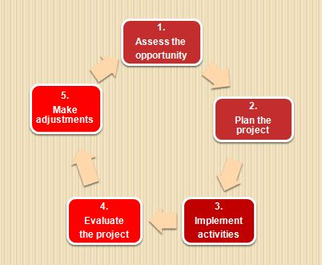
An evaluation and making adjustments are the fourth and fifth stages of the planning process
Notes:
After an on-going relationship has been started, the Public Outreach Committee will find it helpful to periodically “take an inventory” of the project. This inventory allows the Committee an opportunity to review the state of its relationship with the treatment center, and the effectiveness of the outreach project.
This also lets the Public Outreach Committee and other members participating in the project to determine if there are adequate resources to continue the project and what action steps can be taken.
The process of evaluating and making the appropriate changes (stage five) to our outreach activities needs to be repeated at regularly scheduled intervals to ensure that our efforts continue to be effective. The local Public Outreach Committee should have a calendar to keep track of these regularly scheduled evaluations, just as the project manager or primary contact maintains a calendar of activities at the treatment facility.
(Click)

Slide 4
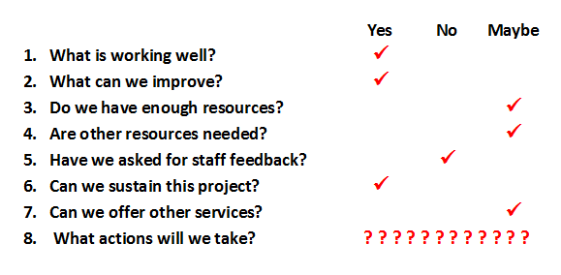
Take an “inventory” of the project
Notes:
Some questions to consider:
What is working well?
What needs to be improved?
Are there additional opportunities for engagement that could build an even stronger relationship between Al-Anon and the facility?
Are there aspects of the project that are not feasible to maintain?
Are additional resources needed to maintain or add our services to the treatment center?
Once the fourth stage, evaluation, is completed, members may wish to modify existing services, add a new service, or discontinue activities that are ineffective or not feasible due to lack resources. This will be the fifth stage of the planning process.
An important aspect of the inventory is feedback from the treatment facility’s professional staff. Their feedback is essential for acquiring a true assessment of the project.
Your staff contact can tell you how your audience is responding to your presentation, what could be added or eliminated from your explanation of
Al-Anon and Alateen, and what literature is or is not helpful.
(Click)

Slide 5
Review the responses to the evaluation questions
Notes:
Once the project inventory is completed, the information needs to be compiled and made available to all members of the local Public Outreach Committee and the project implementation team.
After everyone has reviewed the information, decisions can be made about the future of Al-Anon’s relationship with the treatment facility.
Keep in mind, like our personal inventories, “yes” and “no” decisions occur in the present moment. If the answer is “maybe,” more background information is needed and an idea can be tabled until it is further explored.
(Click)

Slide 6
Stage five Make needed adjustments
Notes:
Once the inventory has been completed and decisions have been made, it’s time to implement the necessary changes.
Remember, the process for developing and maintaining a project doesn’t end here. Plan to reevaluate any adjustments made to our services and resources at a later date. This will help determine if the changes made were correct and help identify any additional changes needed. Be mindful that what was feasible today may not be tomorrow and vice versa.
(Click)

Slide 7
Congratulations! Your outreach project at a treatment facility makes a difference
More families of alcoholics and staff know about
Al-Anon
A relationship with the facility has been established and is being maintained
You are involved in Twelfth Step work
Notes:
The Public Outreach Committee has built and is maintaining a relationship with the treatment center. And, because of this, more friends and families of alcoholics are finding the hope and help that Al-Anon offers. In addition, Al-Anon members are engaged in Twelfth Step work, and are finding a growth opportunity in this service project.
(Click)

Slide 8
Say “Thank you!”
Notes:
Don’t forget to say “thank you” to the members participating in the outreach activities.
For some members, it is the first time they are aware of their growth and have shared the message with others.
(Click)

Slide 9
Celebrate the project
It’s an opportunity to
Thank members for their participation
Share personal growth from service with other members
Recognize our commitment to Al-Anon’s Twelve Step work
Have fun and fellowship
Notes:
It is important to give recognition to the members who have given their time to coordinate outreach activities at treatment facilities, have given presentations, and replenished supplies of our literature. They have generously given their time to inform family members and staff about Al-Anon and Alateen.
When members hear about the spiritual benefits of participating in outreach to treatment centers from other members, they begin to understand how Al-Anon service could help them in their own recovery.
Remember, enthusiasm is contagious. Having a special celebration is also an opportunity to attract new volunteers to participate in this outreach project, and future outreach projects.
(Click)

Slide 10
Thank facility staff for…
Don’t forget to
Referring family members to Al-Anon
Requesting our services
Providing time and space for our presentation
Distributing our literature and meeting schedules
Informing their colleagues about Al-Anon and our
services
Notes:
Our cooperation with professionals results in a better understanding of our program and utilization of Al-Anon as a resource for the family members receiving the services offered by the facility. Even when a treatment center does not have a program, counseling, or therapy for family members, in-take or primary care staff can make information about Al-Anon available to the relatives and friends of clients.
A simple message of thanks to the facility, Family Program Coordinator, Family Services counselors, and therapists, in a note, phone call, or e-mail message may be all that is necessary.
(Click)

Slide 11
Offer additional service projects
Provide Al-Anon information to other departments and facility locations.
Offer presentations to alcoholic patients/clients.
Start a regular Al-Anon group at or near the facility.
Now’s
the
time
Al-Anon Family Group Headquarters, Inc.
Notes:
Once the Public Outreach Committee and members providing the existing services to the facility feel the activity is functioning smoothly, they can consider offering other types of outreach activities.
For example, a treatment center that has a family program may also provide service to parents who have a teen or young adult who is receiving care from the center’s youth program.
Some facilities have satellite offices or offer services in other locations. Some treatment centers are headquartered in one city, but have facilities in other cities, states, or provinces.
(Click)

Slide 12
Ready to contact another facility?
Notes:
Using the knowledge and experience gained from the outreach activities conducted at the first facility, the Pubic Outreach Committee may wish to discuss the feasibility of reaching out to another facility. If so, the five stage planning process starts all over again!
Note to Presenter or small group study coordinator:
a) A question/answer or comment session can be held if time permits.
b) A trusted servant from the hosting Al-Anon service arm may wish to lead a discussion of the next steps to be taken.
c) Exit from the PowerPoint presentation.

