Slide 1
Al-Anon Outreach to Treatment Facilities Building relationships between professionals and family members
Module One
Preliminary preparations
Notes:
Notes to Presenter:
1. Refer to Section One: Outreach to Treatment Facilities User’s Guide for in-depth background information.
2. Read title/topic to audience.
This presentation is the first of four modules provided by the WSO, to support districts and Al-Anon Information Services in their outreach activities. Each module is intended to help and encourage Al-Anon members to engage in Twelfth Step work at treatment facilities or substance abuse agencies in their communities.
(Click)

Slide 2
Module One
What do we want to accomplish?
Preliminary preparations
Notes:
Note to Presenter: Read title/topic to audience.
Summary of content:
First, we’ll briefly summarize the benefits of reaching out to treatment facilities—what you can hope to accomplish.
Second, we’ll summarize the preparations that are necessary before you begin the process of assessing an opportunity and planning a project.
(Click)

Slide 3
What can we accomplish?
Introduce Al-Anon to families
and professionals
Build a cooperative relationship
with professionals
Help families transition into
Al-Anon
Engage Al-Anon members in
Twelfth Step work
Notes:
Essentially, there are four reasons to reach out to treatment facilities:
First, we want the family members of alcoholics in treatment to be aware of the Al-Anon program, and the help that Al-Anon could offer them. We also want the professional staff at a treatment center to be familiar with Al-Anon and the support that it provides.
Second, we want the professional staff at the facility to understand the various ways that local Al-Anon service arms could cooperate with them.
Third, by cooperating with the professional staff and providing them with information about local meetings, we can help the families of alcoholics in treatment find their way to their first Al-Anon meetings. We can help ease family members’ anxieties, fears, or misconceptions about Al-Anon by giving them basic information about Al-Anon and about our meeting format.
Fourth, “Carrying the message” (Step Twelve) is an important part of
Al-Anon’s recovery program. Twelfth Step work gives members a vital opportunity for personal growth in the program.
(Click)

Slide 4
Preliminary preparations
Notes:
Presenter: Read title/topic to the audience.
A specific outreach project is more likely to be effective and sustainable when it is well-organized and properly planned. Also, a well-organized activity will give the members who volunteer to participate with a more satisfying and enjoyable experience. And when they feel good about the project, they will be more willing to remain involved in outreach activities at the treatment facility.
As we’ll see, each project has a five-stage cycle of assessment, planning, implementation, evaluation, and adjustments.
But before you begin this process for any specific project, it is important to put some basic resources into place. These preliminary preparations are will enable you to work more effectively on specific outreach opportunities.
(Click)

Slide 5
Form a Public Outreach Committee
Notes:
First, it is vital to have a local Public Outreach Committee at the District or
Al-Anon Information Service (AIS) Public Outreach level.
Even if there are only two or three members on the Committee, having a Committee means that carrying Al-Anon’s message to a treatment center does not depend solely on one individual.
If the local Public Outreach Committee is ambitious and wants to organize several projects, it may wish to form a Treatment Facility Outreach Subcommittee to focus consistently on outreach opportunities in this area. The Subcommittee’s role is to make recommendations to the local Public Outreach Committee, which has oversight for one or more service projects at a treatment center.
(Click)

Slide 6
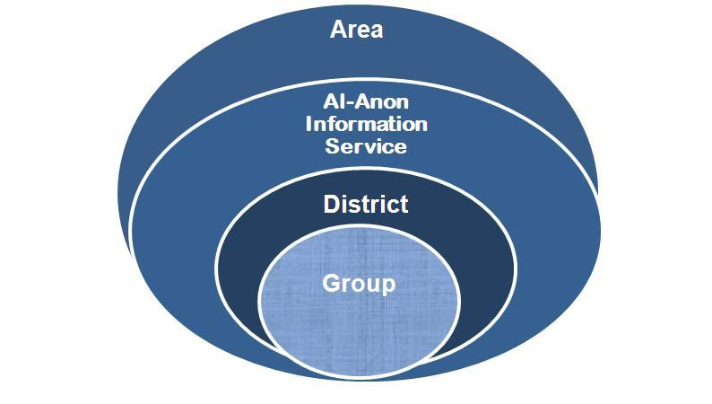
Support for the local Public Outreach Committee
Notes:
This chart identifies Al-Anon’s “links of service” (also known as “service arms”) that can provide information and other types of support to a local Public Outreach Committee. Each Area has a Public Outreach Coordinator* who can share service experiences and timely information with the local Outreach team.**
The Area Public Outreach Coordinator can also refer the local Public Outreach Committee Chairpersons or a member designated to represent the Committee to other trusted servants and members who are or have participated in outreach activities at treatment facilities.
There may be members of local Al-Anon groups who are familiar with outreach at treatment facilities . They could be helpful.
Our message of hope is more likely to be available on a consistent basis when a local Public Outreach Committee cooperates with the Al-Anon service structure, rather than “going it alone.”
* Some Areas may have Institutions, Cooperating with Professional Community (CPC), or Public Information (PI)Coordinators instead of a
single Public Outreach Coordinator.
** Some districts and AISs use the term, “Chairperson” instead of “Coordinator.”
(Click)

Slide 7
Cooperate with Alcoholics Anonymous (A.A.)
A.A. Treatment Facility Committees can help open doors by:
Introducing Al-Anon members
to staff
Inviting Al-Anon members to participate in their presentations
Distributing our contact information
Notes:
It may also be helpful for the local Public Outreach Committee to cooperate with local A.A. Treatment Facility Committees, which may already be doing service work at the same center. The A.A. members may be willing to introduce Al-Anon members to a facility staff member or suggest a contact for us on the professional staff.
Al-Anon members can also ask the A.A. members to inform alcoholic patients/clients about our program. A cooperative relationship with a local A.A. Treatment Facility Committee can be particularly helpful when a treatment center has only out-patient services for the alcoholic, or does not have any services for family members.
(Click)

Slide 8
Take an ‘inventory’ of basic resources
What resources do we have now?
What resources are missing?
How can we acquire the resources we don’t have?
Al-Anon Family Group Headquarters, Inc.
Notes:
Some problems can be avoided or quickly resolved when the local Public Outreach Committee discusses the resources it has (or does not have) prior to the initiation of a specific Al-Anon service project at a treatment facility. Then the local Committee is prepared to evaluate what is available for a specific project, as those opportunities arise.
(Click)

Slide 9
Funds for literature and supplies
Possible sources
Money or literature contributions from groups or other service arms
Al-Anon Literature Distribution Center (LDC)
Special fundraising events
Notes:
A local service arm may be willing to create a budget to purchase the literature and materials needed to implement an outreach activity. The Area Public Outreach Coordinator sometimes has a budget for outreach materials, and can offer assistance to help local projects. However, the local Al-Anon service arm sponsoring the project is responsible for providing the literature and supplies needed to maintain public outreach activities.
It may also be necessary for the local service arm to host special fundraising events. A pot luck supper or group anniversary with speakers may help raise money for the materials needed. Fundraising activities can be fun, as well as creative.
Another alternative is to ask groups to pass the basket an additional time at a meeting, or to simply increase their contributions to the district or AIS to help fund the project.
(Click)

Slide 10
Al-Anon Public Outreach service tools are available to support you
Notes:
There is no need to worry about background “how to” information for planning and implementing outreach projects at treatment facilities.
The local Public Outreach Committee should become familiar with these resources before beginning work on specific projects.
(Click)

Slide 11
Visit the “Public Outreach” section of the WSO Members’ Web site www.al-anon.org/members
Notes:
Note to Presenter: Read the slide title (heading) to the audience.
(Click)

Slide 12
Home Individuals Service Structure WSO Public Outreach Alateen
Notes:
The red highlighted area indicates the three divisions of the “Public Outreach” section that are tailored to specific audiences. The fourth division is like an on-line library. It has links to helpful outreach materials that support members with their project planning and implementation of Al-Anon’s services at treatment centers. .
Note: Some Areas include outreach to treatment facilities as part of their Institutions services. The majority of Areas have consolidated treatment center activities into “Outreach to Professionals” or “Outreach to the Public/Media.”
(Click)

Slide 13
Resources
Guidelines
Notes:
The shared experiences of members are available in Resources and the WSO Guidelines subdivisions. Each item has a link to it.
The Best of Public Outreach is accessible here as well as from the Public Outreach “home page” subdivisions (Institutions, Professionals, and Public/Media).
The annual Al-Anon Faces Alcoholism magazine is ideal as introductory educational material for family members. It has basic information
about Al-Anon, stories from members, and articles by professionals. A Portable Document Format (PDF) file of the current issue can be viewed and ordered on-line.
The Public Outreach CAL Catalog gives members an idea of the variety of
Al-Anon literature that can be provided to treatment facility staff and to family members.
The WSO Guidelines help members with Public Outreach services. They are useful within the fellowship and have presentation ideas for treatment center staff and family members of alcoholics.
(Click)

Slide 14
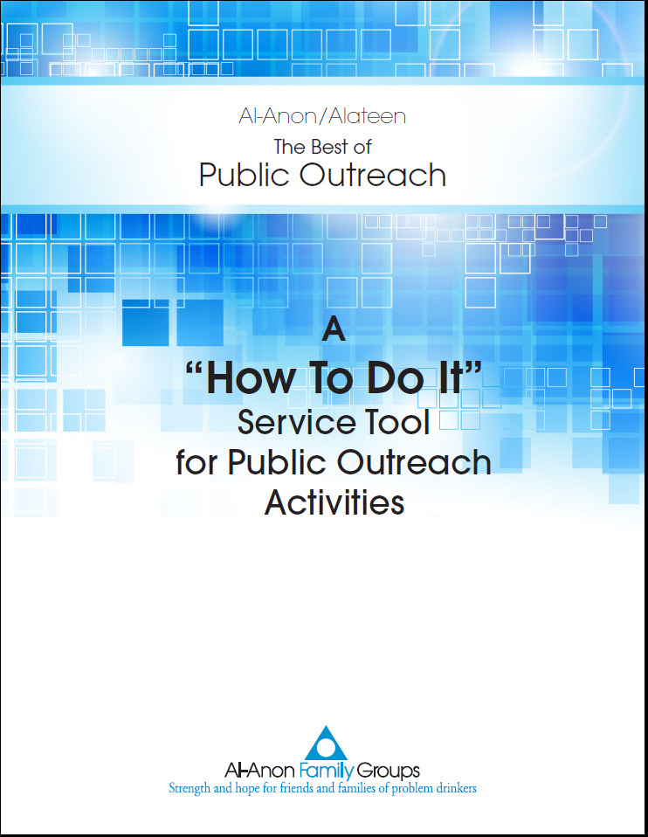
Your in-depth on-line resource www.al-anon.alateen.org/members
The Best of Public Outreach
Service activities and
support materials
Treatment facility
locator Web sites
Al-Anon Family Group Headquarters, Inc.
Notes:
The Best of Public Outreach can be accessed from the four divisions of the Public Outreach “home page” and from most of the sections of the Members’ Web site.
(Click)

Slide 15
Two possible starting points
Notes:
Specific projects can be initiated in one of two possible ways.
(Click)

Slide 16
A treatment facility staff member contacts Al-Anon
Notes:
Sometimes, a professional at a treatment center will call an Al-Anon service arm with a simple request. The facility might want local meeting schedules or introductory literature.
Other inquiries might be more challenging and require more planning and a higher level of commitment. For example, a facility staff member might ask
Al-Anon members to share their recovery stories, provide introductory meetings, or start an Al-Anon group at the facility.
(Click)

Slide 17
2. Al-Anon selects a facility to contact
Notes:
Al-Anon members don’t have to sit by the phone, and wait for a treatment facility to call. A local Public Outreach Committee or an Al-Anon service arm can reach out and call a treatment facility at any time.
Some treatment centers will offer family support services, while others do not. But even if the facility does not offer professional services to the families of alcoholics, the facility might still appreciate the opportunity to make Al-Anon available to the families of their clients.
(Click)

Slide 18
Both approaches can be effective
Notes:
Both possible starting points can lead to a cooperative and sustainable relationship between Al-Anon and the treatment facility.
(Click)

Slide 19
Congratulations! Now it is time for Module Two
Notes:
Note to Presenter: Read title/topic to the audience. Continue with Module Two.
(Click)

